Slide 1
Computer Networks Presentation BLOCKCHAIN & SECURITY
Presented by:
Divyansh Chhablani (B025)
Naman Garg(B032)
Programme: BTech CS B

Slide 2
INTRO
Nowadays, all information systems, computational tasks and
data storage operates in a distributed manner for reliability, accessibility, parallelism or geographical purposes. The
data replication minimizes the latency and avert the loss.
Moreover, several nodes may bear some lapses and continue
to process functions properly. Nevertheless, distributed technologies have many advantages, they also present several
problems.
Several systems flaws threaten DLTs(Distributed Ledger Technologies) security and privacy. This mainly depends on the consensus algorithm in use and its relative considerations.

Slide 3
Introduction to Security and Privacy on the Blockchain
Research has been made even more difficult as the privacy and security properties of Bitcoin were never formally stated by Nakamoto in a provable manner, and so these properties have only recently begun to be formalized.

Slide 4
I. IMPROVEMENTS TO CORE CRYPTOGRAPHIC PRIMITIVES
With Bitcoin and variants being developed by practitioners rather than cryptographers, the trust tends to be put not in formal proofs and properties but in practical resistance to attacks based on common knowledge and experience by practitioners.
does “the blockchain” refer to to any linked list built out of pointers that are cryptographic hashes, or does it refer to particular design choices done by Bitcoin?

Slide 5
Critiques
proof of work : sybil attacks
Proof-of-Personhood
Proof-of-stake
Notes:
where a malicious attacker can flood a decentralized network with users that are secretly controlled by the attacker. Although the use of hashing as proof-of-work allows new participants to join the blockchain in a ’permissionless’ fashion seems to have worked so far
“Proof-of-Personhood: Redemocratizing Permissionless Cryptocurrencies.

Slide 6
PRIVACY AND ANONYMITY ON THE BLOCKCHAIN
Bitcoin offers only pseudonymous transactions. As Bitcoin is a shared global public ledger, pseudonyms may be de-anonymized by determining patterns of usage in the blockchain. This is in contrast to previous well-studied and even deployed systems.
Notes:
based on centralized Chaumian e-cash that have well-defined privacy properties, such as enforcing privacy between senders and recipients of transfers, given by well known primitives such as blind signatures. Yet it seems a public ledger is needed to prevents double-spending attacks, so any user can read and possibly write new information to let some information become public knowledge

Slide 7
We have seen two approaches to the problem
One is to add anonymization to the existing blockchain by techniques such as Confidential Transfers
new blockchains that are incompatible with Bitcoin, such as Zerocash (zero-knowledge “succinct non-interactive argument of Knowledge” SNARKS)
The current design of Zerocash has no audibility, a property possessed by Chaumian e-cash as deployed by DigiCash. The paper “Auditable Zerocoin” allows Zerocoin to be audited, given that auditing may be needed to prevent charges such as those of being a money transmitter; charges that destroyed preBitcoin electronic currencies such as eGold

Slide 8
NEW FRONTIERS FOR BLOCKCHAIN RESEARCH
When it actually makes sense in terms of security to deploy a blockchain to a new problem is one of the most important question
smart contracts : auto executing contracts.
One of the more classical yet exciting use-cases would be the sharing of files in a more anonymous fashion than allowed by current P2P networks based on Bittorrent
Notes:
A smart contract is a computer program or a transaction protocol which is intended to automatically execute, control or document legally relevant events and actions according to the terms of a contract or an agreement

Slide 9
On Blockchain Security and Relevant Attacks
The main purpose in this work is to spot the attention on several issues in each blockchain network. It covers scalability measures, consensus algorithms, mining computations and nodes fairness.
I.COMPARISON OF BLOCKCHAIN PLATFORMS
II.DLTs SECURITY CHALLENGES
III.ATTACKS

Slide 10
COMPARISON OF BLOCKCHAIN PLATFORMS
Following are the subtopics in the paper:
A. Blockchain Overview
B. Features
C. Blockchain Networks
D. Permissionless or Permissioned Network
E. Scalability

Slide 11
Blockchain Overview
Transactions signing and verification mechanisms utilize cryptographic algorithms, precisely Elliptical Curve Digital Signature Algorithm (ECDSA), to establish the relations between the several blocks.
In order to confirm entries, a merkle tree root hash is used to condense the data hashed into blocks.
Each header holds the value of a previous hash, a nonce, the charge of a transaction (gas), a mathematical measure to assess the accuracy of a transaction (difficulty) and other constraints that diverge between DLTs.
Ethereum header - three trees are available for transactions outcomes and account handling.
Hyperledger block - has a distinct structure alienated between block header, block data and block metadata.
Notes:
Gas fees are payments made by users to compensate for the computing energy required to process and validate transactions on the Ethereum blockchain.

Slide 12
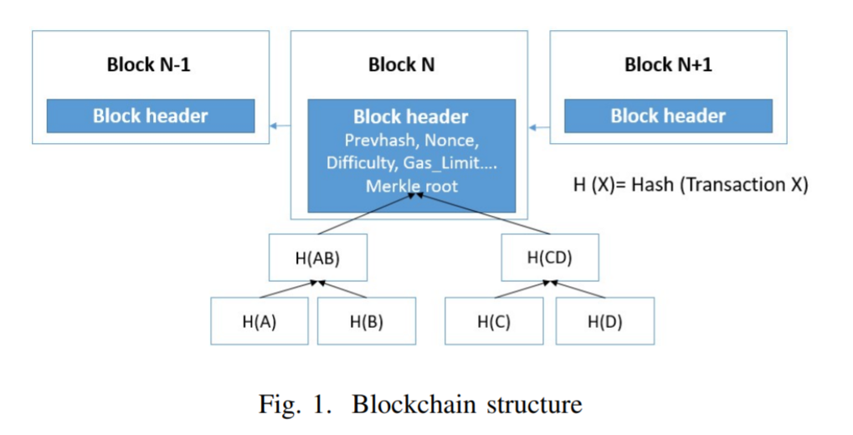

Slide 13
Features
Regardless of the DLT type, the blockchain technology offers numerous security characteristics:
Immutability
Auditability
Integrity
Authorization
Fault Tolerance
Transparency
Availability
Consistency
Privacy
Notes:
• Immutability: Once added to a block, a transaction becomes irremovable.
• Auditability: Each block is characterized by cryptographic schemes and secure timestamping offering the
capacity to audit each transaction.
• Integrity: The SIGHASH function validates the signatures
ensuring that any modification will invalidate the transaction.
• Authorization: Elliptical Curve Digital Signature Algorithm (ECDSA) is used to create the links between the
blocks.
• Fault Tolerance: Many agreement mechanisms are involved to achieve the consensus in DLTs.
• Transparency: The transactions are appended into blocks
and replicated publicly to the peers.
• Availability: Even if peers exit the network, the
blockchain network is continually available.
• Consistency: Once the miners agree on the consensus and
block arrangement, the distributed ledger is consistent and
changes are infeasible.
• Privacy: While the distributed ledger is public, keys
relatives to each parties are anonymous

Slide 14
Blockchain Networks
Bitcoin:
Digitally signed transactions are maintained by a public ledger representing the same data.
In order to interrelate with the blockchain, a transaction is broadcasted into the network and validated by all peers.
A block holds the information related to each transaction and once a consensus is achieved, the block will be appended the blockchain.
The process will start over for every new transaction.

Slide 15
Blockchain Networks
Ethereum and Hyperledger:
As for Ethereum and Hyperledger, the same set of interactions is used. However, a new concept of smart contract is introduced:
Each contract instance will be wrapped up in the payload of each transaction and will circulate in the network depending on the gas limit, etc.
Each receiving peer will execute smart contract functions creating a native replica of each contract in their current state.

Slide 16
Permission-less or Permissioned Network
Permission-less network - everyone can contribute in the canonical chain
Bitcoin and Ethereum are permission-less blockchains that rely on a a Proof-of Work (PoW) consensus.
PoW - Powerful hardware have higher reward probability
The new Ethereum Serenity release is moving to the Casper protocol which is a Proof-of-Stake (PoS) algorithm.
PoS - penalize incorrect bets, less time consuming
Notes:
PoW is based on the machine power to resolve the cryptographic challenges consuming large amounts of electricity
Therefore, the resolution and reward probabilities are higher for nodes with powerful hardware leading to regulate the network.
The new Ethereum Serenity release is moving to the Casper protocol which is a Proof-of-Stake (PoS) algorithm where the different nodes are penalized if they bet incorrectly on a block. Also, one more benefit of this type of consensus is that the PoS is a less time consuming algorithm.
Nodes in the network don’t spend time and electricity to solve a mathematical problem to reach a consensus; instead, they place a bet on blocks. When a block is appended to the chain, whoever had placed a bet on it, gets rewarded.
The fundamental difference lies in the way how each method handles the dishonesty in the network. In PoW, if someone tries to cheat when creating a block, their dishonesty is forgiven by the other nodes in the network. In PoS, the dishonesty is penalized instead. Because forgiveness is the default in the former, there’s nothing stopping people from being dishonest. On the other hand, the PoS makes sure that dishonesty is severely discouraged by putting the penalty.

Slide 17
Permission-less or Permissioned Network
Permissioned network - limits the number of peers who can access the blockchain and participate in the validation
Hyperledger is permissioned blockchain. The number of participants is limited and managed by the system
The distributed ledger only include a set of definite transactions associated to each node.
Notes:
In a Hyperledger DLT, when a node broadcast a transaction, it will be forwarded to the ordering service to apply numbering identification in order to the peers to agree later on the same transactions sequence

Slide 18
Scalability
Scalability remains a main challenge in DLTs, specifically for the Bitcoin and Ethereum networks where a copy of the complete history needs to be stored in each node.
One-megabyte block size in Bitcoin leads to delays and drop of not conform blocks.
To overcome this:
Request Management System based on advertising requests was introduced as well as static time-outs.
Moreover, bidirectional channels were presented.

Slide 19
Scalability
Ethereum - Many functions are duplicated leading to scalability issues.
Solution:
State and plasma channels - offline and off-chain activities. Also enforces anonymity.
Sharding technique - splitting account states into separate chunks

Slide 20
Scalability
Hyperledger can scale independently for each node without disruption since:
Peers are abridged into endorsers, committers and consenters.
The parallel transactions processing in the hyperledger blockchain leads to a higher throughput.

Slide 21
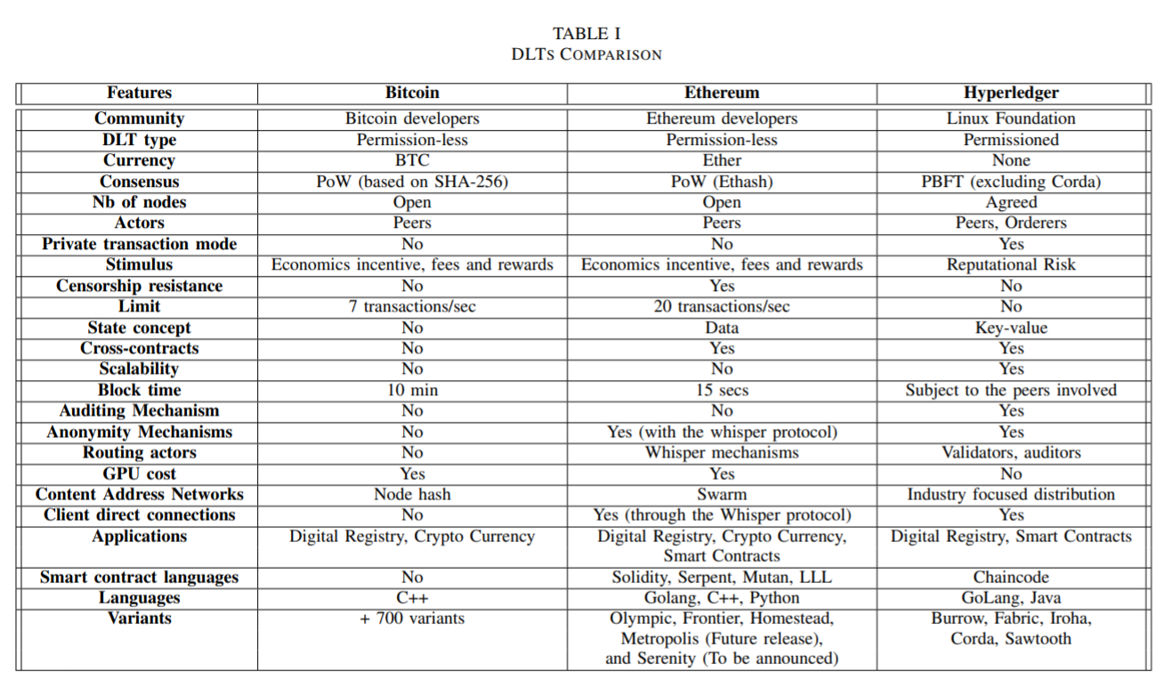
Comparison of DLTs

Slide 22
DLTs SECURITY CHALLENGES
Blockchain mining malware and DoS attacks are reported constantly.
In this section, we analyze smart contracts and lightweight clients vulnerabilities in addition to networks and consensus challenges in Blockchains.
We read about:
Consensus
Wallets
Smart Contracts Vulnerabilities
Lightweight Clients
Cryptography contravention

Slide 23
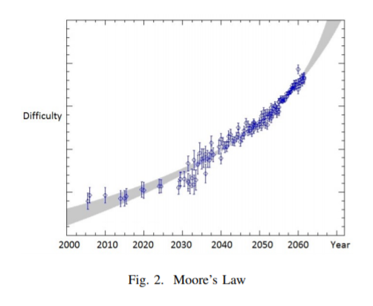
Consensus
Several consensus algorithms have been employed in DLTs depending on the altcoin type.
For Bitcoin and Ethereum early releases the PoW algorithm suffers from multiple drawbacks:
Moore’s Law: Computation power will double every two years and block difficulty will grow exponentially over time
Notes:
As Bitcoins are mined, blocks of verified transactions have to be “hashed” before being added to the ever growing chain of blocks, AKA the blockchain. Each of these hashes is created by successfully completing an intentionally difficult mathematical puzzle. The hash rate, is a measure of how many times the network can attempt to complete this puzzle every second.

Slide 24
Consensus
Thus, a malicious miner can assemble hashing power of authentic validators and forge an attack at time T2 > T1 to model the entire history at time T1.
Besides, if the network dramatically loses mining computation power, block creation decelerates widely.
Thus, the necessity to increase block difficulty exponentially and the need to provide enough soft fork time for all parties to updates their states.
Notes:
Hard forks and soft forks are essentially the same in the sense that when a cryptocurrency platform's existing code is changed, an old version remains on the network while the new version is created. With a soft fork, only one blockchain will remain valid as users adopt the update. Whereas with a hard fork, both the old and new blockchains exist side by side, which means that the software must be updated to work by the new rules. Both forks create a split, but a hard fork creates two blockchains and a soft fork is meant to result in one.

Slide 25
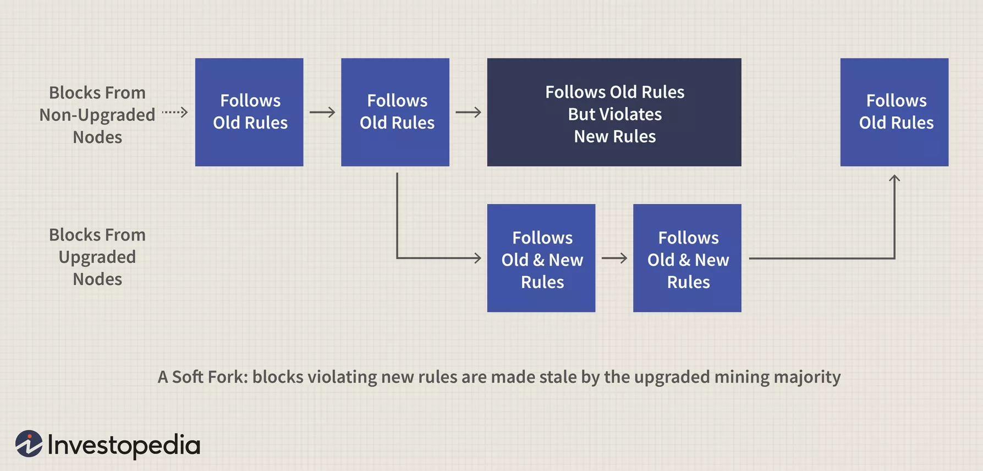
Soft Fork
Older rules invalidated, new rules accepted
This kind of fork requires only a majority of the miners upgrading to enforce the new rules, as opposed to a hard fork that requires all nodes to upgrade and agree on the new version.
Notes:
Hard forks and soft forks are essentially the same in the sense that when a cryptocurrency platform's existing code is changed, an old version remains on the network while the new version is created. With a soft fork, only one blockchain will remain valid as users adopt the update. Whereas with a hard fork, both the old and new blockchains exist side by side, which means that the software must be updated to work by the new rules. Both forks create a split, but a hard fork creates two blockchains and a soft fork is meant to result in one.

Slide 26
Wallets
The principal purpose of wallets is to keep private keys.
There are several types of wallets online and offline.
These wallets are subjects to failure or attacks, and in some scenario not irreversible.
The introduction of multi-signature addresses and cloud storage systems may enable damage resistance unless collusion.

Slide 27
Smart Contracts vulnerabilities
Mostly all smart contracts are prone to faults due to the programming language weaknesses, especially in an Ethereum network.
Besides, after a block is appended to a chain, code errors are inept to be removed because transactions are permanent.
Notes:
Smart contracts are lines of code that are stored on a blockchain and automatically execute when predetermined terms and conditions are met. At the most basic level, they are programs that run as they’ve been set up to run by the people who developed them.

Slide 28
Smart Contracts vulnerabilities
Solutions:
Auditing mechanism: checking and reviewing of smart contract functions.
Writing smart contract with an induced validity date after which this later will expire.
Notes:
For instance, when deploying a transaction with an infinite loop, as long as gas fees are sustained, the operation is valid but not effective. Also, Ether may be lost in the transfer if the address of the recipient is not valid. Many solutions for these issues have been recognized in a Hyperledger network, introducing smart contracts endorsement to eliminate security flaws.

Slide 29
Smart Contracts vulnerabilities
Moreover, publicly exposing new vulnerabilities will let the attackers perform duplicitous actions. Furthermore, during the time of an attack, many DLT functions become unuseful.
For instance, when deploying a transaction with an infinite loop, as long as gas fees are sustained, the operation is valid but not effective.
Many solutions for these issues have been recognized in a Hyperledger network, introducing smart contracts endorsement to eliminate security flaws.
Notes:
Also, Ether may be lost in the transfer if the address of the recipient is not valid.
An endorsement policy is very important; it indicates which organizations in a blockchain network must sign a transaction generated by a given smart contract in order for that transaction to be declared valid. Every smart contract has an endorsement policy associated with it.

Slide 30
Lightweight clients
Inevitably, the security included in lightweight clients is lower than in the standard nodes.
However, this leads to the loss of important information such as peers addresses and chain height.
Therefore, malicious nodes may forbid the adoption of the chain forged by the light client by convincing this later that his chain is not the longest chain.

Slide 31
Lightweight clients
Moreover, owning several bloom filters decreases the privacy. Besides, in order to reduce the bandwidth, light client take advantage of bloom filters that may result in false positives.
Moreover, an adversary can make a link between the filters and the client to learn its address.
To encounter this issue, using anonymization system like Tor might be advantageous.
Notes:
A Bloom filter is a data structure designed to tell you, rapidly and memory-efficiently, whether an element is present in a set. The price paid for this efficiency is that a Bloom filter is a probabilistic data structure: it tells us that the element either definitely is not in the set or may be in the set.

Slide 32
Cryptography contravention
ECDSA [22] and secp256k1 [23] are considered strong cryptographic schemes.
However, they might be cracked by private key harvesters in the far future.
Thus, an attentive and innovative approach needs to be considered in future releases architectures.

Slide 33
Attacks
This section exposes multiple attacks scenarios that can be performed on DLTs and summarizes the results of the two attacks that have been simulated.
Transactions Security
Spam attacks
Malicious Contracts
Anonymity
Mining pools
Targeted DDoS attacks
Timejacking attacks

Slide 34
Transactions Security
Blockchain security depends on cryptographic schemes and is based on keys management over the network.
The transactions authenticity is corroborated applying digital signatures and each transaction point to the previous one.
Each transaction is broadcasted between the peers for validation.
Whereas, this allows adversary to delay the message delivery and may help in conducting double-spending.
Also, another implication is denying the delivery of transactions.

Slide 35
Transactions Security
Moreover, a more recurrent example of exploitation consists in controlling the target user inbound and outbound connexions by implementing an eclipse attack.(simulated in the research)
A double-spending attack was performed during block forks where typically in similar scenario the longest chain is adopted.
Double spend attacks: 0-confirmations and N-confirmations
Notes:
In an eclipse attack, the malicious actor will ensure that all of the target’s connections are made to attacker-controlled nodes. The entity will first flood the target with its own IP addresses, which the victim will likely connect to upon the restart of their software. A restart can either be forced (i.e. with a DDoS attack on the target), or the attacker can simply wait for it to occur. https://academy.binance.com/en/articles/what-is-an-eclipse-attack#introduction

Slide 36
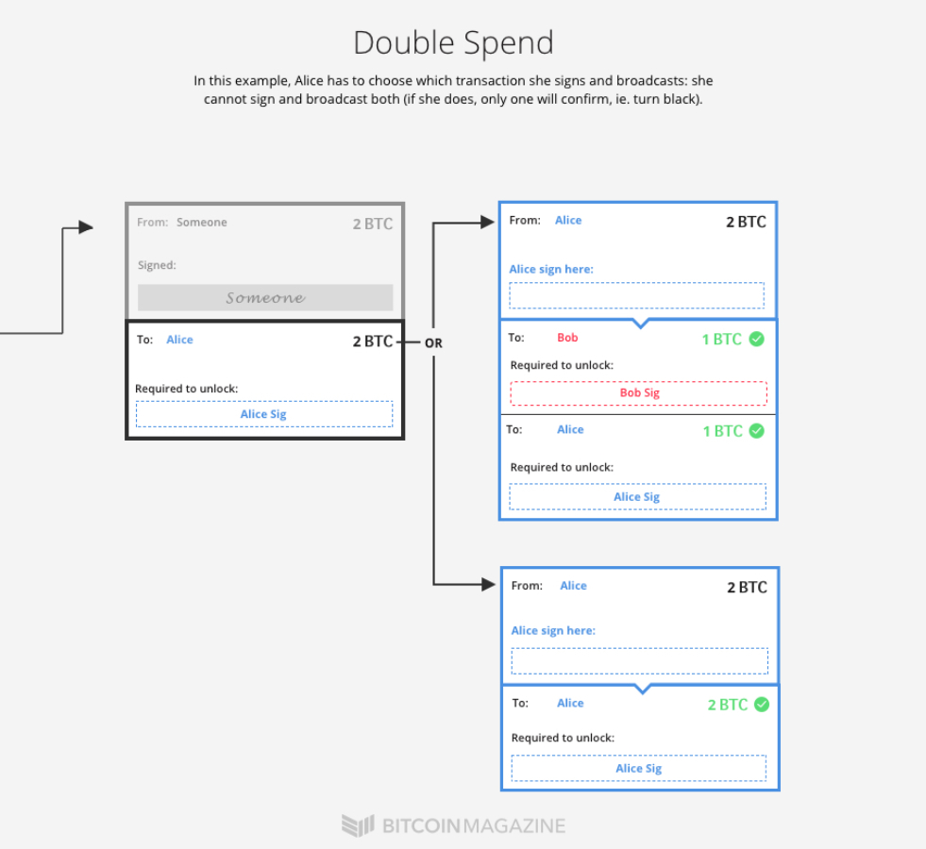

Slide 37
Spam attacks
A spam attack consists in pledging transactions that bear how users handle data, decelerating the network and delaying the creation of blocks while losing gas and computation power. This result in decreasing of the number of reachable peers and entire network outage
Notes:
"Gas limit" refers to the maximum amount of gas (or energy) that you're willing to spend on a particular transaction. A higher gas limit means that you must do more work to execute a transaction using ether or a smart contract.

Slide 38
Malicious Contracts
Smarts contracts cannot handle code exceptions and procedures restructuring while transactions are validated.
Transactions may become postponed or inaccurate.
“We simulated a Re-entrancy attack using Ganache that provides a web interface for the truffle framework, installs on our machine a private blockchain network of five nodes and interacts with our Ethereum wallet where our malicious smart contract is created and signed.”

Slide 39
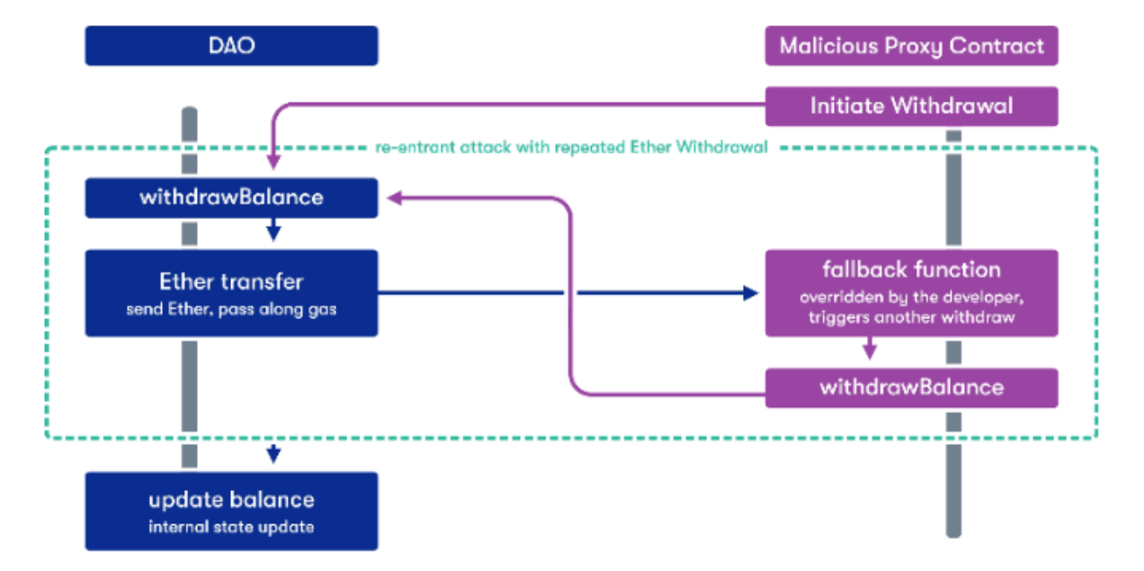
Malicious Contracts
The purpose is to execute the same reentrant function by a contract before the initial process has terminated.
Using the call function will invoke the interaction with the main contract several times before its execution is completed, causing bugs.

Slide 40
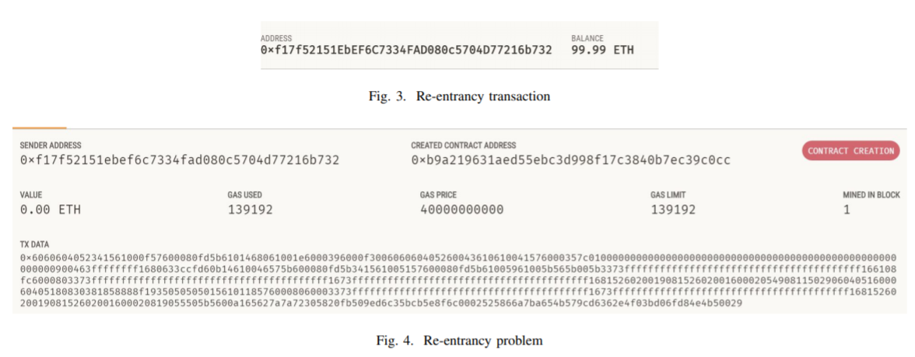
Malicious Contracts
As shown in Fig. 3 and Fig. 4, there has been contract creation without spending Ether (VALUE=0.00 ETH) whereas the user has lost 0.01 ETH (BALANCE=99.99 ETH)
Notes:
However, if the attacker called back multiple times without any gas limitations, the execution will continue until the user loses all his funds or until the maximum call stack depth is reached.

Slide 41
Malicious Contracts
However, if the attacker called back multiple times without any gas limitations, the execution will continue until the user loses all his funds or until the maximum call stack depth is reached.
Notes:
A smart contract is a computer program or a transaction protocol which is intended to automatically execute, control or document legally relevant events and actions according to the terms of a contract or an agreement

Slide 42
Anonymity
Metadata exposure disturbs the participants anonymity and reduce confidentiality. Besides, being aware of a user’s address will lead to the history and exchanges tracking for financial and non-financials applications.
Pseudo-anonymity identity mixer relying on cryptographic schemes in the Hyperledger network
Whisper routing protocol in Ethereum blockchain to conceal sensitive interactions

Slide 43
Mining Pools
Joining a mining pool needs to be performed using consciousness.
The control over a mining consortium depends on the hashing rates and the number of confirmations. In a PoW consensus, these parameters cannot mitigate the risk of attack.
The research simulated a majority attack targeting the bitcoin network.
This attack permits to take control over the mining hashing power and thus conducting other malevolent behaviors.

Slide 44
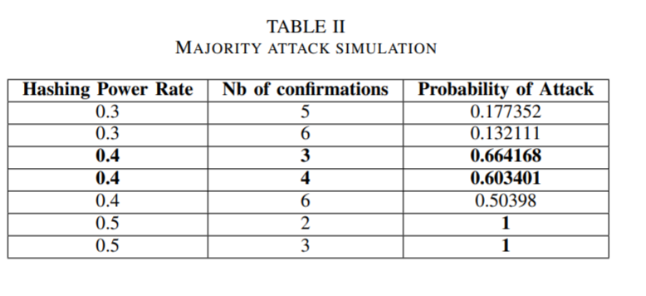
Mining Pools
They demonstrated that a lower amount of confirmations will lead to a higher risk level.
Probability (0.5, Nb of confirmations)= 1
Notes:
For that purpose, we connected to test network of ten different nodes. The results of our simulation are abridged in Table II. We demonstrated that a lower amount of confirmations will lead to a higher risk level. This type of attack is a consequence of other malevolent scenarios such as stealing user machine power through trojan system exploitation, use timestamps dependency attack to manipulate the mining or add Call stack depth limit function and loops that can trigger gas limit.

Slide 45
Targeted DDoS attacks
These attacks consist in flooding the network by lots of information in a way it become irresponsive to transactions.
Taking main peers offline for some period of time in order to forge additional validation results in serious consequences in DLTs applications.
We can cite client protections related to the amount of check-signature, block size limitation, orphan transactions banning and ignorance of not standard transactions.

Slide 46
Timejacking attacks
An attacker could typically change node’s network time counter by involving as multiple peers as possible and broadcasting wrong timestamps in the network.
This results in speeding up other peers and isolating the target out of the network without interference from authentic nodes.
The tightening of time range and the usage of peer’s system timing or Blockchain median time, might be possible solutions.

Slide 47
Security Applications and Challenges in Blockchain
Blockchain has not created brand new and innovative applications as it has enhanced currently existing applications. Due to its versatile usage, Blockchain has been a beneficial factor in enhancing application performance and their security. In this section, we will elaborate on the implementation of Blockchain as a security asset for established applications.
Two major applications which will be highlighted in this section are Pretty Good Privacy (PGP) and ProvChain

Slide 48
PGP is an encryption program which provides the user with privacy as well as authenticity in their data communication through the use of cryptography. PGP is significantly enhanced through the use of Blockchain and more specifically Bitcoin based Blockchain technology.
ProvChain is a Cloud data storage application which enhances its availability and privacy through the use of Blockchain. Specifically, Blockchain provides the Cloud in ProvChain with a form of data provenance.
Notes:
In a decentralized architecture such as Blockchain, every node participates in the same network in order to provide its expected service, thereby providing enhanced efficiency as well. Availability of the Blockchain network is also ensured because of its innate distributed characteristics

Slide 49
Problems with Current PGP: ensuring a secure connection between two or more parties relies on encrypting a public key within a Public Key Infrastructure (PKI).
there is a third party called the certification authority (CA)
PGP is the best alternative for PKI since it has increased protection due to being a decentralized model based on the web of trust. few weaknesses which include:
● “subjective” system of honor
●relationships that are trusted are first degree relationships
● It’s challenging to create levels of trust with meaningful values ● There are some serious problems being reliant on “web of trust” such as certification and endorsement of another user’s public keys

Slide 50
The first level is unknown; this is when nothing is known about the owner’s judgement when it comes to signing other keys.
none; this means the owner is known to be untrustworthy with their key signing and should be avoided.
marginal; which indicates that the owner understands what it means to sign a key and should properly validate a key before they actually sign them. (business contracts)
full; this means the owner is great with their key signing and his signature would be just as good as your own. (family)
ultimate; it should not be used on anyone other than yourself. Using ultimate level of trust on anyone else is a security risk that is not worth risking as it means fully trusting everyone;

Slide 51
Blockchain in PGP also allows for a Bitcoin-based PGP key server design. This method uses the Bitcoin transaction Blockchain in order to securely store PGP keys . A Bitcoin based server allows for a decentralized client-based network which would allow all users to store and retrieve desired PGP certificates in the Blockchain efficiently

Slide 52
Limitations
● Too much overhead in key maintenance
● Compatibility issues with different versions of PGP
● Authentication issues
● The honest policy within PGP is not trustworthy
● The web of trust isn’t scalable

Slide 53
Smart Contracts in PGP
They allow transactions between two independent parties to take place without a third party.
Criminals can use smart contracts for malicious reasons in order to steal confidential information. These kinds of contracts are called Criminal Smart Contracts
A thief can propose a fair exchange between 2 people. The contractor will pay a reward to the perpetrator if he is able to provide a valid password. This entire transaction from start to finish takes place without a third party involved. Since smart contract is used alongside Blockchain, it cannot access the network directly, so the validity of the password is proven through HTTPS . Once the data is received, the thief can decrypt and verify the data and send payment if the data is correct.

Slide 54
ProvChain
ProvChain is a data provenance architecture in a Cloud environment.
It uses Blockchain to enhance both the privacy as well as the availability of its data.
So how does it enhance its privacy?

Slide 55
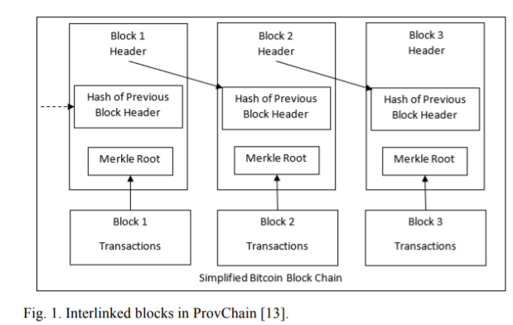
Each block contains a hash of the previous block, if there is a previous block, as well as a hash of the current block.
Each block contains additional data including a timestamp of when the data was stored.

Slide 56
In ProvChain, users’ operations are being monitored in real-time in order to collect and store their data in real-time as well.
Each data provenance record in the blockchain is associated with a hashed user ID.
In the blockchain network, each node is in charge of its own piece of data, but it cannot correlate data to a specific user of the blockchain. The only thing capable of correlating data to a specific user is the service provider.

Slide 57
Some other broad concerns regarding the use of Blockchain are the following:
● Integration concerns as Blockchain is a new technology thus determining whether integration between new or existing systems are difficult.
● Cultural adoption as both users and operators need to invest in Blockchain to create a better market.
● Cost of the initial implementing Blockchain is high.
● Uncertain regulatory status as stated is fairly new thus, many government regulations are unsettled.
● Fictitious Blockchain applications can be created to steal transaction details and personal information

Slide 58


Slide 59
Comparative Analysis of the papers based on certain criterion
The first research paper talks about the vulnerabilities, attacks and possible solutions in general. Whereas, the second research paper talks about the technologies that are making the blockchain more secure.
All three papers talk about usage of smart contracts and their limitations in the blockchain.
The second research paper mentions a technology which uses blockchain’s anonymity as a feature. However, this anonymity is restricted in the sense that the service provider is aware of the users involved and all transactions can be traced back to hashed user ID.
The first paper mentions the possibility of leakage of user data through metadata. It also mentions the solution of using pseudo-anonymity identity mixer(Hyperledger) and Whisper routing protocol(Ethereum) to conceal sensitive interactions.
Notes:
The second paper shows a technology which implements smart contracts to solve its limitations, however it acknowledges that Criminal Smart Contracts exist and process of performing thefts through CSCs is simple.
The first research paper explains how smart contracts work and it also experiments with vulnerabilities involving smart contracts(Malicious Contracts). It also mentions a solution implemented in Hyperledger, “smart contracts endorsement”.

Slide 60
Conclusion
The aforementioned vulnerabilities present huge risks on blockchains networks leading to serious consequences. Possible countermeasures consist in using a recent timestamped address and utilizing it once, inflicting penalties, connections filtering, adding time-outs to queries and multiple auditing mechanisms.

Slide 61
Conclusion
To conclude, securing DLTs rely on the capacity to protect
the private keys. Nevertheless the Blockchain advancement
during the late ten years, many security issues and scalability
challenges necessitate to be tackled.
Finally, businesses must pay attention when designing their
applications and several characteristics are to be considered
while choosing the best model to use. For instance, legal and
regulatory frameworks are needed to manage blockchains and
their uses.
Notes:
academia vs developers. activism, history, good idea turned bad, vested interests.

Slide 62
References
https://ieeexplore.ieee.org/abstract/document/7966963
https://ieeexplore.ieee.org/document/8371010
https://ieeexplore.ieee.org/document/8661914
https://bford.info/pub/dec/pop.pdf

